Slide 1
Smart Traffic Management System for Urban Congestion
CSE7302- University Project
Review-5
Batch Number: CSE_14
Roll Number | Student Name
Under the Supervision of
Ms. Kummara Sruthi
Assistant Professor
School of Computer Science and Engineering
Presidency University
20221CSE0234 | Syed Thousif
20221CSE0217 | Gajjula Ashok Vardhan Reddy
20221CSE0213 | Kambam Nithin Kumar Reddy
Name of the Program: CSE-Computer Science and Engineering
Name of the HOD: Dr. Asif Mohammed
Name of the Program Project Coordinator: Dr. Jayavadivel Ravi
Name of the School Project Coordinators: Dr. Sampath A K , Dr. Geetha A

Slide 2
Content
Problem Statement
Literature Survey
Objectives
Existing Methods & Drawbacks
Proposed Methods
Architecture Diagram
Modules & Technologies
GitHub Link
Working Screenshot
Timeline of the Project
References

Slide 3
Problem Statement
Urban areas are experiencing severe traffic congestion due to the rapid increase in vehicles and inefficient traffic management systems. Traditional traffic control methods rely on fixed signal timings and manual monitoring, which are unable to adapt to real-time traffic conditions. Drivers also spend significant time searching for parking spaces, which further increases congestion and fuel consumption.

Slide 4
Literature Survey
Ref | Author | Drawbacks in Existing Work | How Our Proposed System Overcomes
[1] | Al-Heety et al. | Complex reinforcement learning models require high computational power and large datasets. | Our system uses lightweight ML models and real-time traffic data for faster and simpler congestion prediction.
[2] | Goswami & Kadao | Focus mainly on signal control and lacks parking management features. | Our system integrates both traffic congestion prediction and parking slot detection in a single platform.
[3] | Xu & Li | Requires multiple data sources which increases system complexity and implementation cost. | Our approach uses simpler data processing with camera-based vehicle detection for practical implementation.
[4] | Prathiba et al. | Digital twin architecture is expensive and difficult to deploy in normal city infrastructure. | Our system provides a low-cost AI based traffic monitoring system suitable for urban environments.
[5] | Wairagade et al. | Limited real-time prediction capability and lacks visualization dashboard. | Our system provides real-time prediction results with a dashboard for easy monitoring and analysis.

Slide 5
Objectives
Predict traffic congestion using AI/ML
Detect available parking slots
Optimize traffic signals
Provide emergency vehicle priority
Improve traffic flow in smart cities

Slide 6
Existing methods and Drawbacks
Existing methods:
Fixed-time traffic signals
Manual traffic monitoring
Limited parking management
Drawbacks:
No real-time prediction
Traffic congestion during peak hours
No emergency vehicle prioritization

Slide 7
Proposed Method
The proposed system uses machine learning algorithms to analyze traffic data and predict congestion levels. Computer vision techniques detect available parking slots, and the system dynamically optimizes traffic signals and routes.

Slide 8
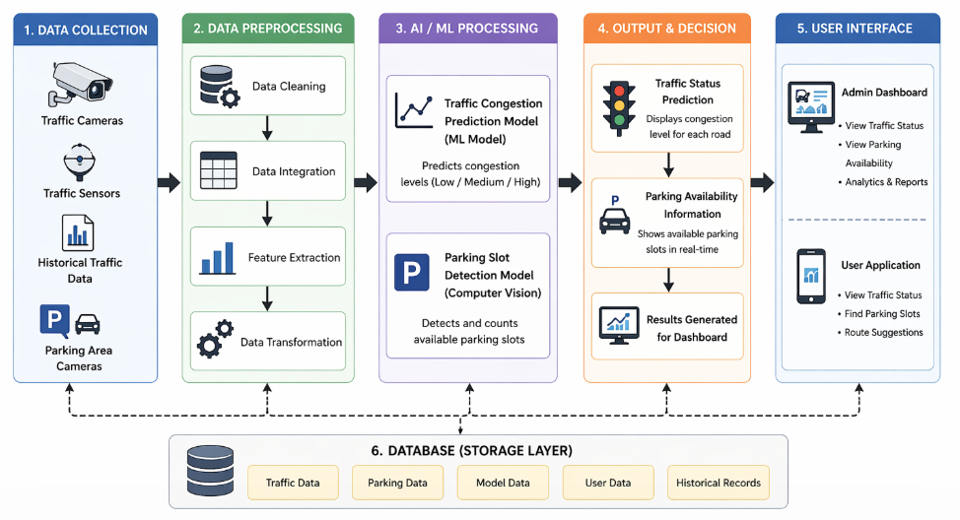
Architecture Diagram

Slide 9
Modules & Technologies Used
The system is divided into several functional modules, including traffic prediction, parking detection, vehicle routing, and user interface management. Each module performs a specific task and contributes to the overall functionality of the system. The project is developed using Python as the primary programming language. Libraries such as OpenCV are used for computer vision tasks, while machine learning models are implemented for traffic prediction. Streamlit is used to build an interactive web interface that allows users to monitor traffic conditions and access parking information.

Slide 10
GitHub Repository
Link: https://github.com/SThousif/Smart-Traffic-Management-System-for-Urban-Congestion

Slide 11
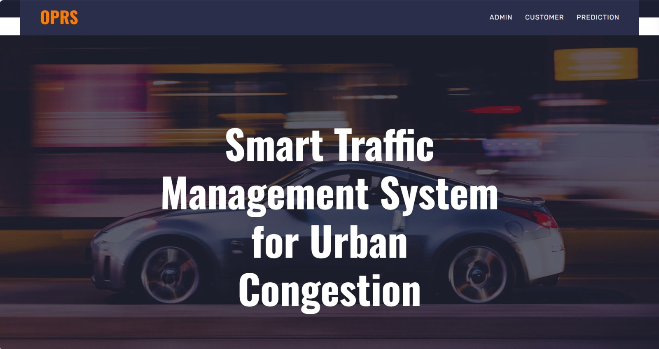
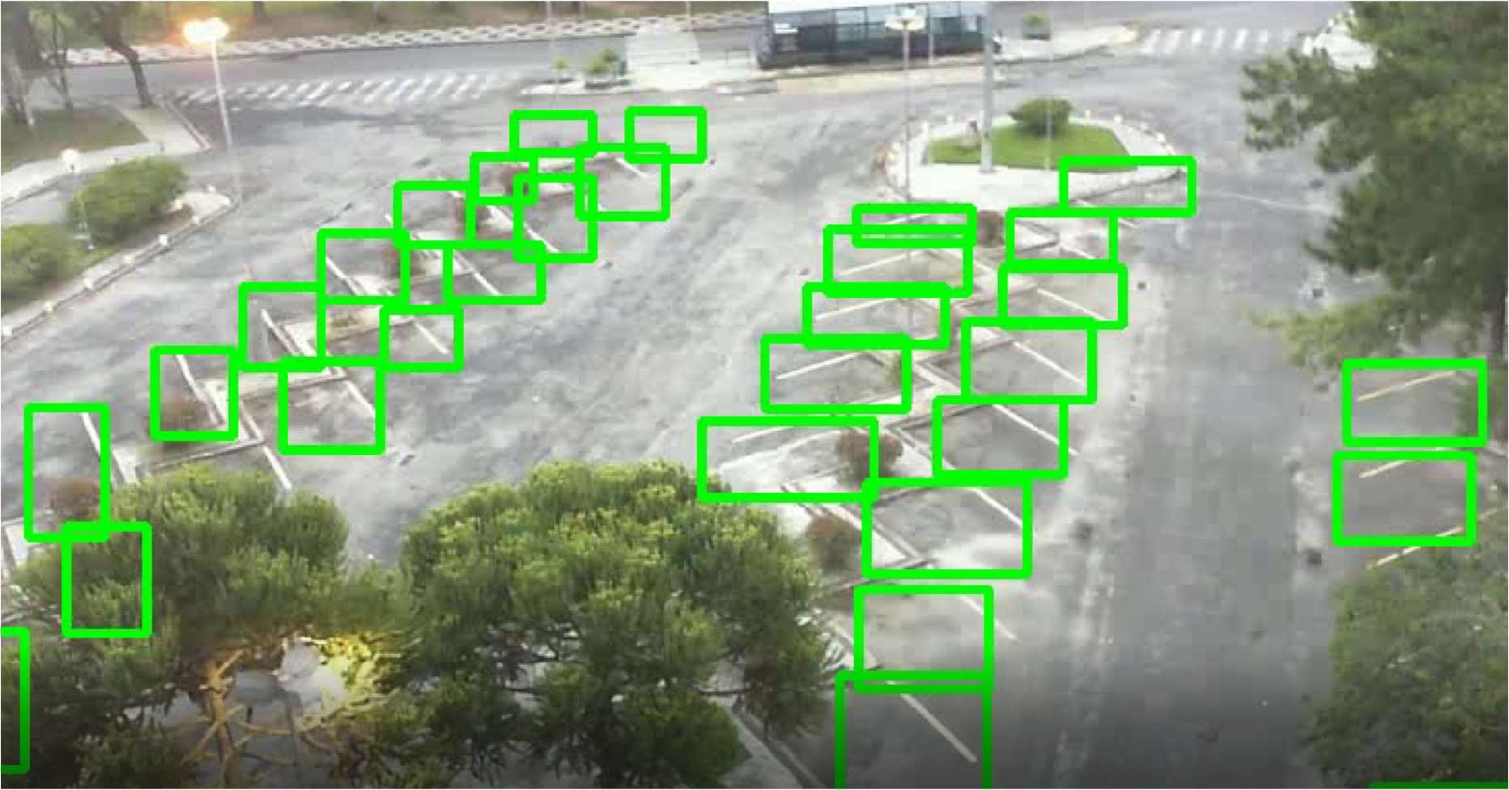
Working Screenshots
Fig. 1. The main landing page providing navigation to parking and traffic prediction features.
Fig. 2. Page showing output of the parking vacancy prediction model with slot availability.

Slide 12

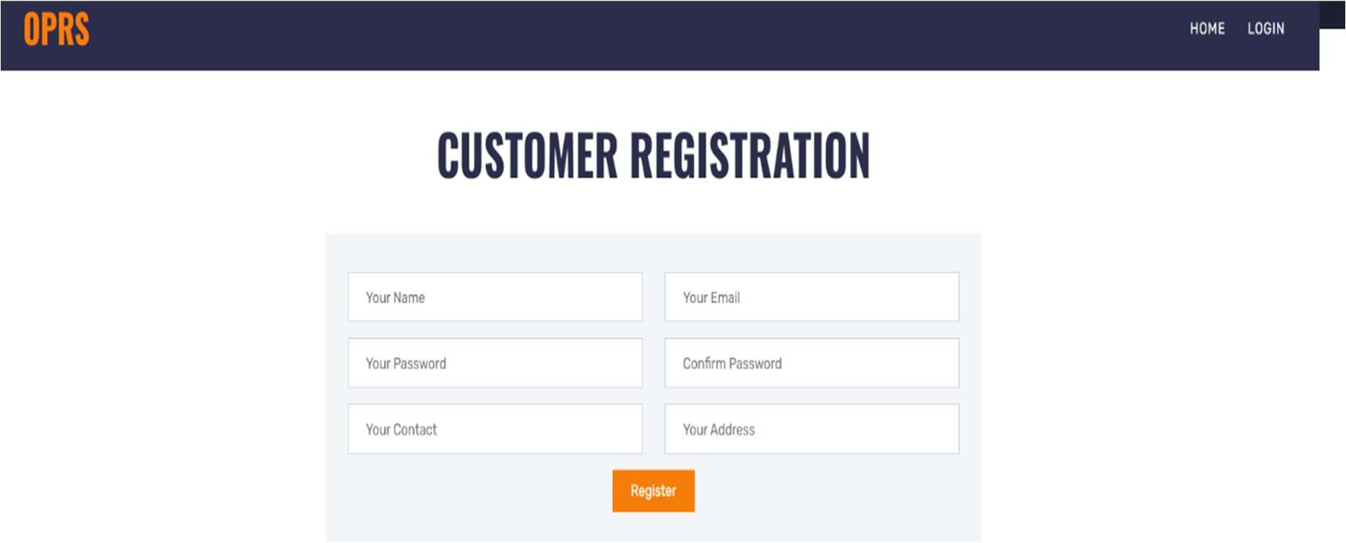
Screenshots
Fig. 3. Secure login interface for administrators to access management functionalities.
Fig. 4. User login interface to access parking and traffic prediction services.

Slide 13
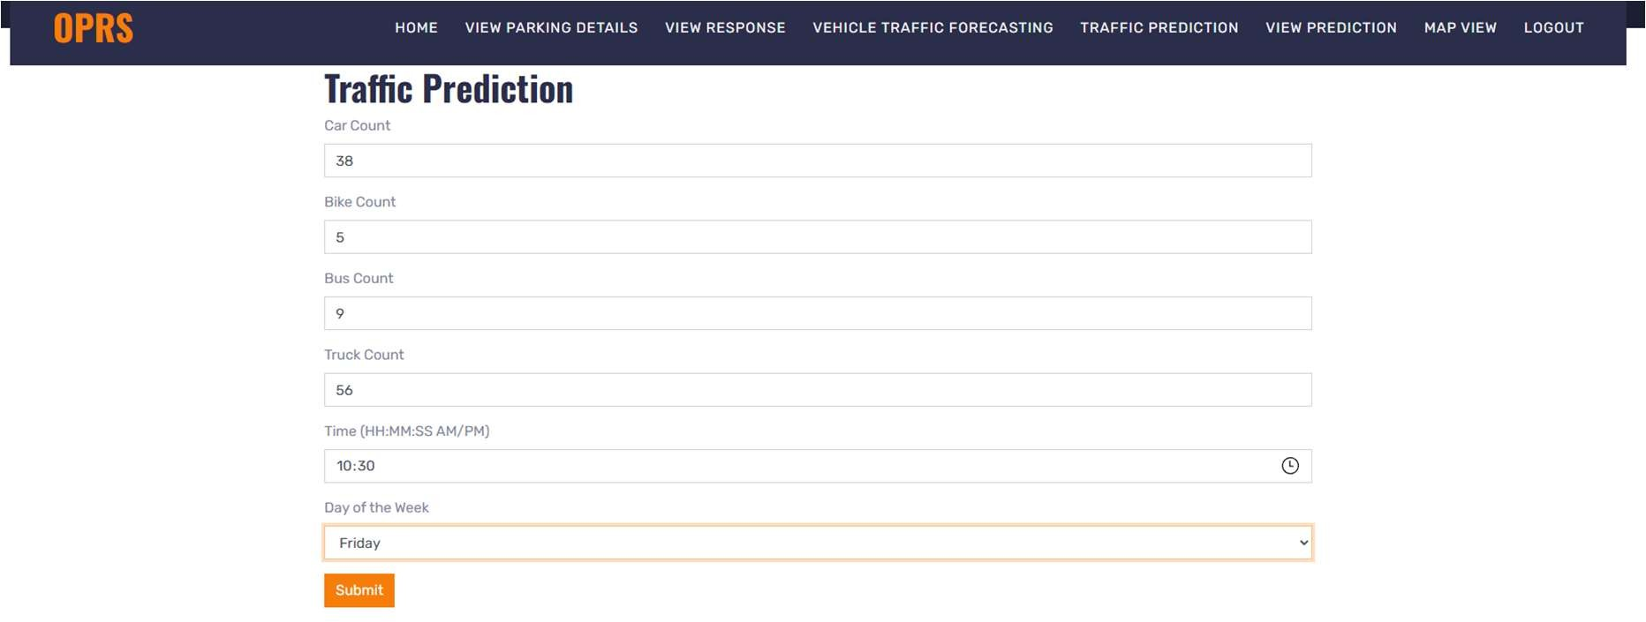
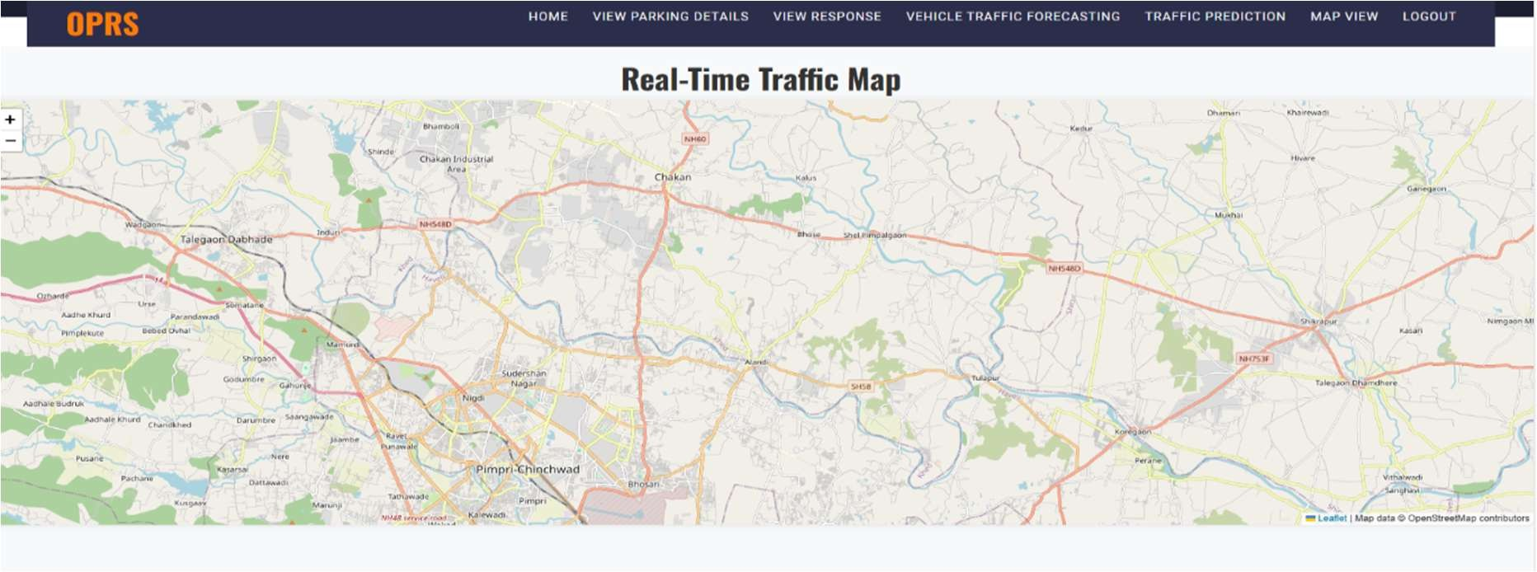
Screenshots
Fig. 5. Visual representation of estimated vehicle flow on different routes.
Fig. 6. Interactive map showing parking locations and real-time traffic data.

Slide 14
Timeline of the Project (Gantt Chart)
Gantt Chart
Phase | Week 1 | Week 2 | Week 3 | Week 4 | Week 5 | Week 6 | Week 7 | Week 8
1. Requirement Gathering & Analysis | ██████ | ██████
2. Design (UI/UX & Architecture) |  | ██████ | ██████
3. Development (Frontend & Backend) |  |  | ██████ | ██████ | ██████
4. Testing & Debugging |  |  |  |  | ██████ | ██████
5. Deployment & Documentation |  |  |  |  |  |  | ██████ | ██████

Slide 15
References (IEEE Paper format)
[1] Al-Heety, O.S., Zakaria, Z., Abu-Khadrah, A., Ismail, M., Shakir, M.M., Alani, S. and Alsariera, H., 2026. Traffic jam control with emergency conscious and reinforcement learning-based non-dominated sorting genetic algorithm. IEEE Access.
[2] Goswami, A. and Kadao, A.K., 2025. Indian metro congestion reduction using smart traffic management systems. Next Generation Smart Systems, pp.1022–1031.
[3] Xu, Y. and Li, Y., 2025. A multi-source data fusion framework of risk field and traffic congestion prediction in real-time urban environments. IEEE Access, vol. 13.
[4] Prathiba, S.B., Krishnamoorthy, S.R., Kannan, K.S., Selvaraj, A.K., Ranganayakulu, D., Fang, K. and Gadekallu, T.R., 2025. Digital twin-powered traffic and power grid optimization system in 6G-driven smart cities in real-time. IEEE Internet of Things Journal.
[5] Wairagade, A., Ugale, K. and Waghmare, R., 2025. Urban congestion reduction using AI-powered smart traffic management system. International Journal of Scientific Research and Engineering Trends, 11(2).
[6] Naramdeo, K., Madake, S., Patil, J. and Patil, P., 2025. Smart traffic management system in urban environment. Journal of Novel Research and Innovative Development, 3(6).
[7] Laanaoui, M.D., Lachgar, M., Mohamed, H., Hamid, H., Villar, S.G. and Ashraf, I., 2024. SETEC: Enhancing urban traffic management using real-time load balancing and anomaly detection. IEEE Access, vol. 12.

Slide 16
References (IEEE Paper format)
[8] Bhat, C.R., Raghunath, K.M.K., Kumar, V.V., Kannan, V.A., Mahesh, T.R., Manikandan, K. and Krishnamoorthy, N., 2024. Redefining urban traffic dynamics using TCN-FL based traffic prediction and control measures. IEEE Access, vol. 12.
[9] Fadila, J.N., Wahab, N.H.A., Alshammari, A., Aqarni, A., Al-Dhaqm, A. and Aziz, N., 2024. Fourth industrial revolution smart urban traffic management at scale: A comprehensive review. IEEE Access, vol. 12.
[10] Wang, C., Ma, X., Jia, L., Lai, Z., Yang, Z., Yan, H. and Zhao, J., 2024. CPS architecture development for urban roadway intersections based on MBSE. Journal of Intelligent and Connected Vehicles, 7(3), pp.190–204.
[11] Xu, H., Berres, A., Yoginath, S.B., Sorensen, H., Nugent, P.J., Severino, J., Tennille, S.A., Moore, A., Jones, W. and Sanyal, J., 2023. Smart mobility in the cloud: Digital twin for situational awareness and cyber-physical control in real-time. IEEE Transactions on Intelligent Transportation Systems, 24(3), pp.3145–3160.
[12] Jin, J., Rong, D., Pang, Y., Ye, P., Ji, Q., Wang, X., Wang, G. and Wang, F.Y., 2022. An agent-based traffic recommendation system: Urban traffic management strategy revisiting and revising. IEEE Transactions on Systems, Man, and Cybernetics: Systems, 52(11), pp.7289–7301.
[13] Oliveira, L.F.P., Manera, L.T. and Luz, P.D.G., 2021. Smart traffic light control system with real-time observation. IEEE Internet of Things Journal, 8(5), pp.3384–3393.
[14] Nagapragna, H. and Joshi, S.S., 2017. Smart traffic management system. Sapthagiri College of Engineering, Bangalore.
[15] Lanke, N. and Koul, S., 2013. Smart traffic management system. International Journal of Computer Applications, 75(7), pp.19–22.

Slide 17


